Slide 1

Inductive bias, Hypothesis, hypothesis space
Dr. Manish Raj

Slide 2

What is this ?

Slide 3

This is :

Slide 4
choose A MODEL
X | Y
2 | 3.4
3 | 5.9
5 | 7.8
7.8 | 6.5
9.2 | 11.7
10.4 | 15.3
11.8 | 17.
MODELS:

Slide 5

choose A MODEL (Assumptions)
X | Y
2 | 3.4
3 | 5.9
5 | 7.8
7.8 | 6.5
9.2 | 11.7
10.4 | 15.3
11.8 | 17.6
MODEL (Assumptions)
1. Y= bx + a
2. Y = $e^{−(bx)}$
3. Y = Sin(x)
4. Y = ${bx}^{2}$
5. Y = $\sqrt{a+bx}$

Slide 6

cHOoSE A MODEL (Assumptions)
X | Y
2 | 3.4
3 | 5.9
5 | 7.8
7.8 | 6.5
9.2 | 11.7
10.4 | 15.3
11.8 | 17.6
MODEL(Assumptions)
1. Y= bx + a
2. Y = $e^{−(bx)}$
3. Y = Sin(x)
4. Y = ${bx}^{2}$
5. Y = $\sqrt{a+bx}$
Chose a model from assumptions
Inductive Bias

Slide 7
Inductive bias
The inductive bias (also known as learning bias) of a learning algorithm is the set of assumptions that the learner uses to predict outputs.
In machine learning, one aim to construct algorithms that are able to learn to predict a certain target output.
Inductive Bias = Y=a+bx (Linear Model)

Slide 8
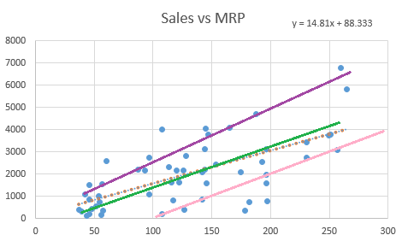
Hypothesis space
Inductive bias = a +bx
Infinite
Infinite

Slide 9
Hypothesis space
Hypothesis space is the set of all the possible legal hypothesis.
This is the set from which the machine learning algorithm would determine the best possible (only one) which would best describe the target function or the outputs.
Best Solution = Hypothesis

Slide 10
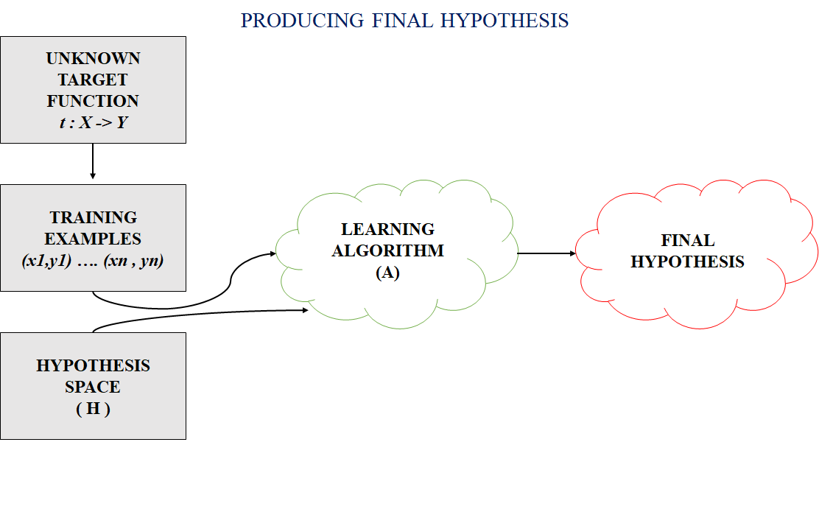
Hypothesis
A hypothesis is a function that best describes the target in supervised machine learning.
The hypothesis that an algorithm would come up depends upon the data and also depends upon the restrictions and bias that we have imposed on the data.

Slide 11
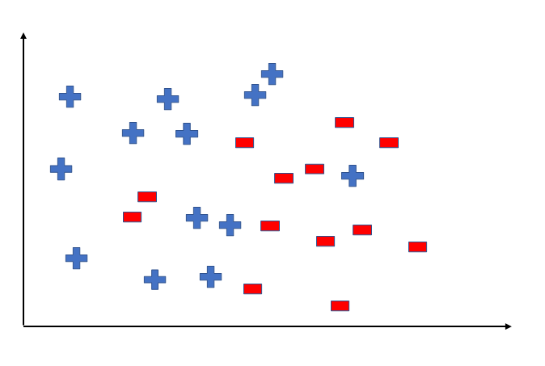
Classification example
To better understand the Hypothesis Space and Hypothesis consider the following coordinate that shows the distribution of some data:

Slide 12
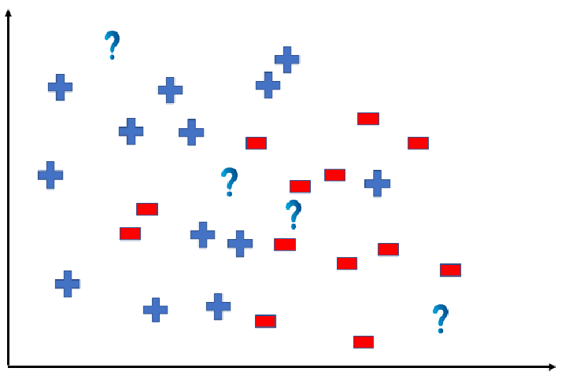
Hypothesis
Say suppose we have test data for which we have to determine the outputs or results. The test data is as shown:

Slide 13
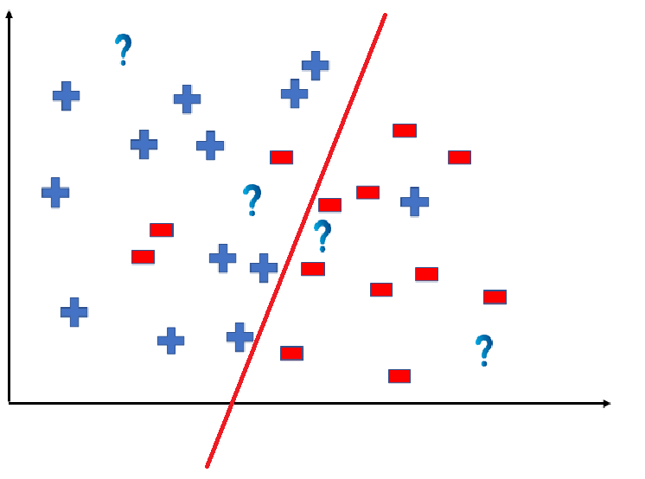
Hypothesis
We can predict the outcomes by dividing the coordinate as shown below

Slide 14
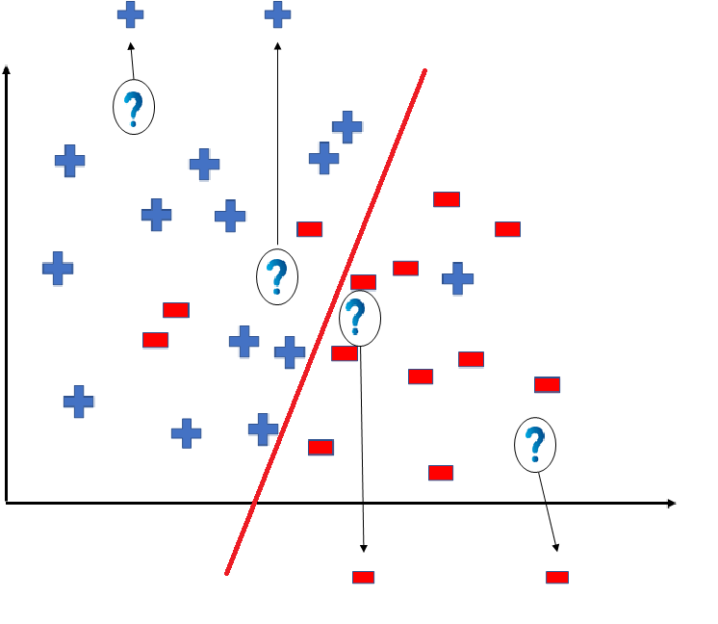
hypothesis
So the test data would yield the following result:

Slide 15
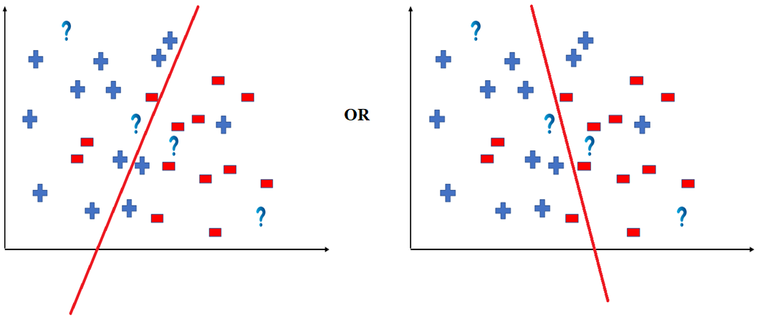

Slide 16
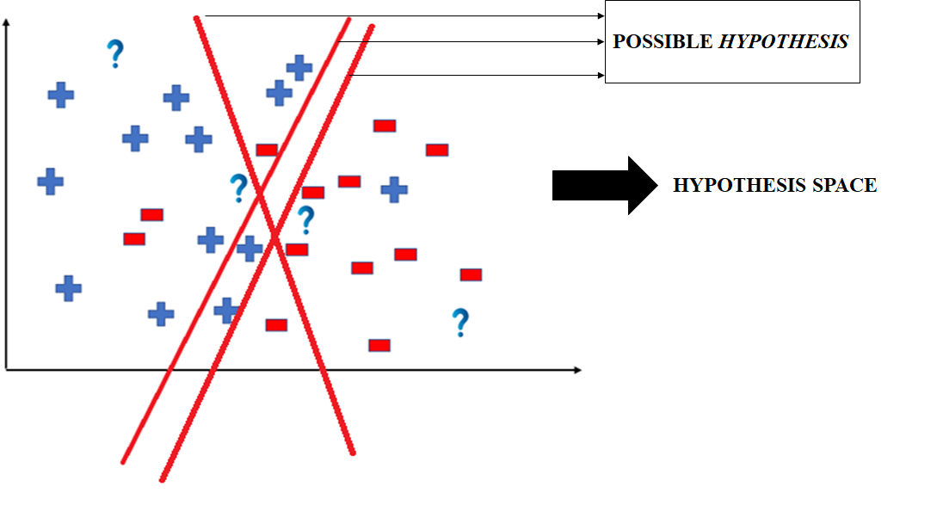
hypothesis
The way in which the coordinate would be divided depends on the data, algorithm and constraints.
All these legal possible ways in which we can divide the coordinate plane to predict the outcome of the test data composes of the Hypothesis Space (H).
Each individual possible way is known as the hypothesis (h).

